Slide 1

ShowerTunes
By Amber Makovicka

Slide 2

The Goals
Use MetaWear CPRO temperature sensor to take current temperature and read in mobile app
Design app to display temperature data
Monitor temperature data for specified threshold
Connect to Bluetooth speaker and register when paired and connected in app
When speaker is connected and threshold is met, play a song in the app
When either device is disconnected or temperature is below threshold, stop playing song

Slide 3

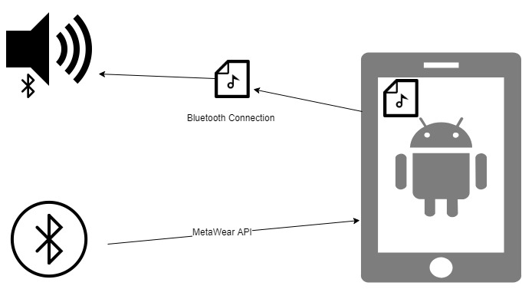
The Design

Slide 4
The Components
MetaWear CPRO
Will record temperatures and report to mobile app
Android application
Will take input from CPRO and Bluetooth speaker
Responds appropriately according to input or lack there of
Generic Bluetooth Speaker
Will output the song
Will start/stop music

Slide 5
Installing Needs
Android 9.0 device
MetaWear device with temperature sensor
Generic Bluetooth Speaker
Android Studio

Slide 6
Installing
TL;DIR
Install Android Studio
Go to Github repository ‘codestuff’ branch and clone/download branch
Open contents in Android Studio
Navigate to app -> Java -> com.example.mbientlab.showertunes -> MainActivity
Edit lines 40-42 for MetaWear and Bluetooth MAC address. Change temperature threshold as fit
Run app from Android Studio to install APK
Wait for thresholds to be met.

Slide 7
Demo (if live don’t work)

Slide 8
Questions?
Show code as necessary

